Slide 1
Pathway Areas of Study
Career and Technical Education

Slide 2
Family & Consumer Science
Business & Marketing
Information Technology
Agriculture
Skilled & Tech
Technology & Engineering
Health Science
7-9
Electives List

Slide 3
7th Grade Electives
Keyboarding
8th Grade Electives
Keyboarding
9th Grade Electives
Art (Drawing/Painting/Ceramics)
Art
World Languages
Beginning Theatre
Choir
Band
Orchestra
Percussion
Study Skills
Art (Drawing/Painting/Ceramics)
Beginning Theatre
Creative Writing
Choir
Band
Orchestra
Percussion
Foreign Language
Digital Literacy
Exploring Business & Marketing
Exploring Technology
Study Skills
Dance 1 & 2
Introduction to Engineering
FACS Foods
FACS Clothing
Intermediate Theater
Stage Technology
Creative Writing
Choir
Band
Orchestra
Percussion
Foreign Language
Exploring Business & Marketing
Computer Technoloy
Exploring Technology
Study Skills
Child Development
Dance 1 & 2
Introduction to Engineering
Food and Nutrition
Clothing and Textiles
Team Sports
Digital Design

Slide 4
Business & Marketing
7-9
Electives List
Accounting & Finance
Business Administrative and Technical Support
Entrepreneurship & Management
Hospitality and Tourism
Marketing

Slide 5
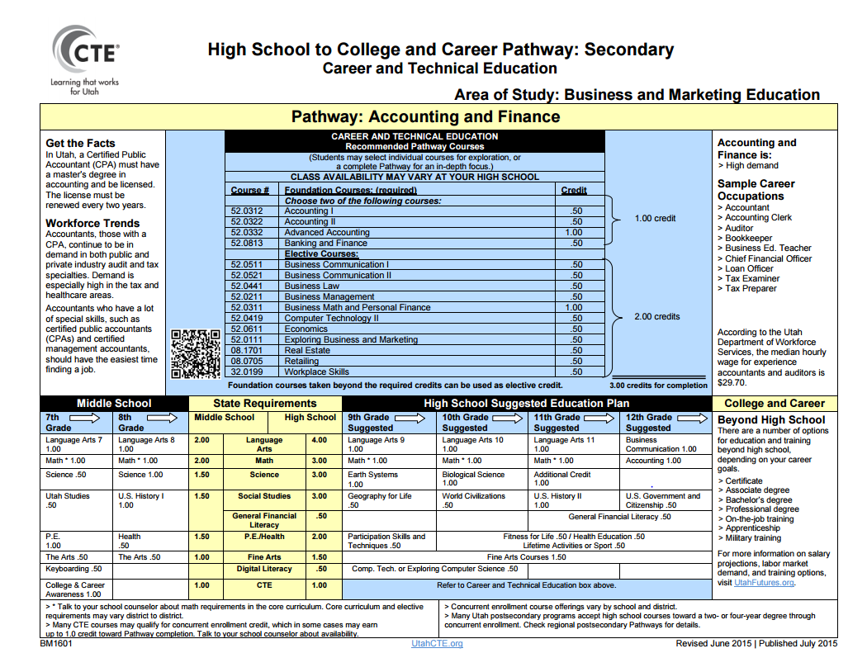
7-9
Electives List
Accounting and Finance

Slide 6
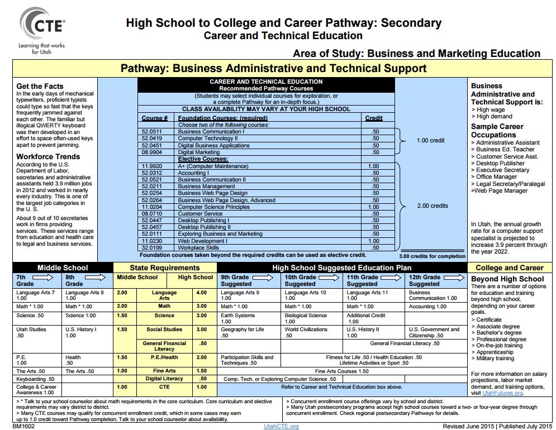
7-9
Electives List
Business Administration

Slide 7
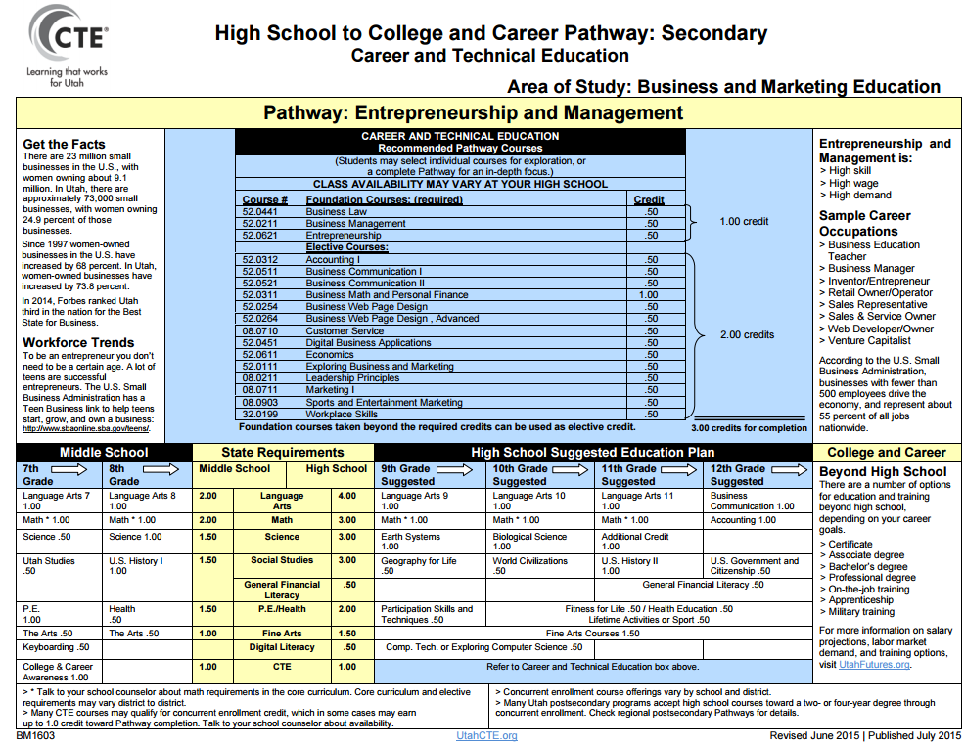
7-9
Electives List
Entrepreneurship & Management

Slide 8
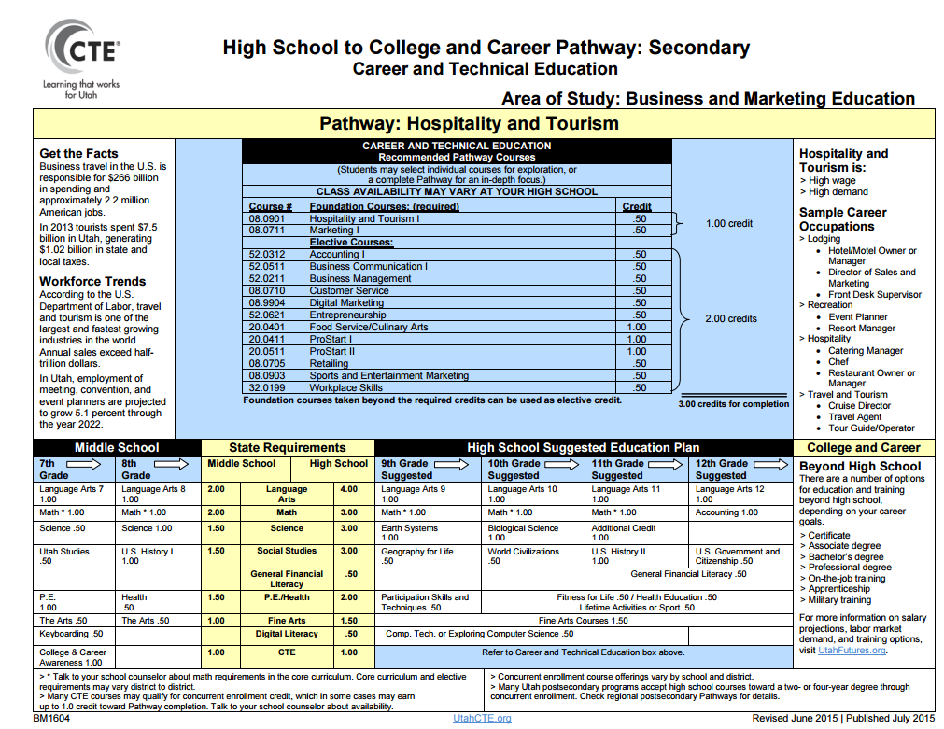
7-9
Electives List
Hospitality & Tourism

Slide 9
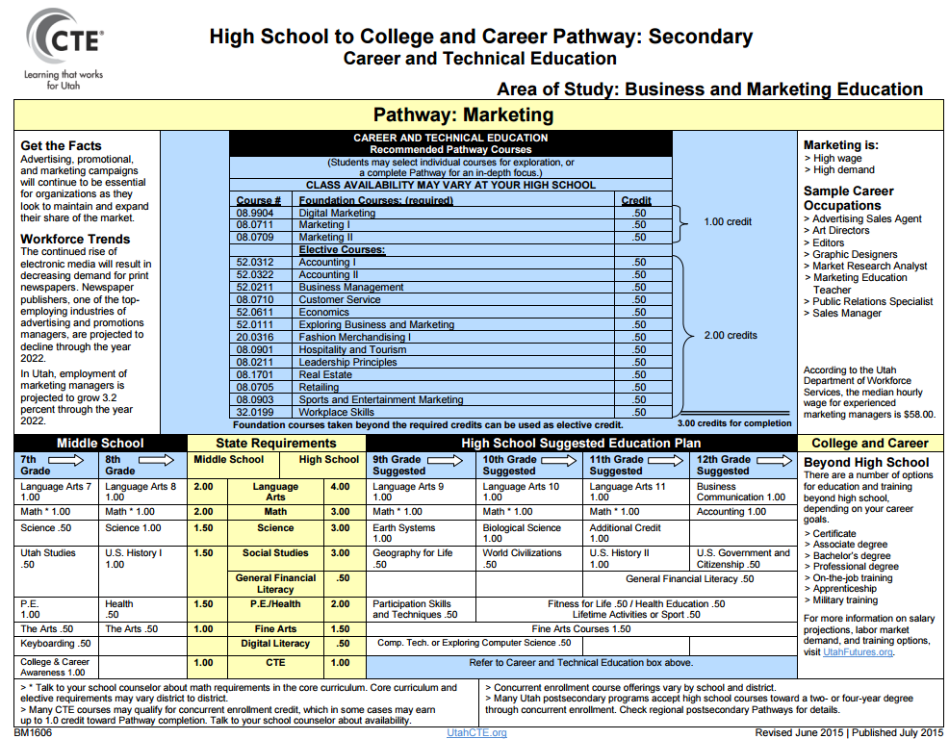
7-9
Electives List
Marketing

Slide 10
Technology & Engineering
7-9
Electives List
Pre-Engineering
Project Lead the Way

Slide 11
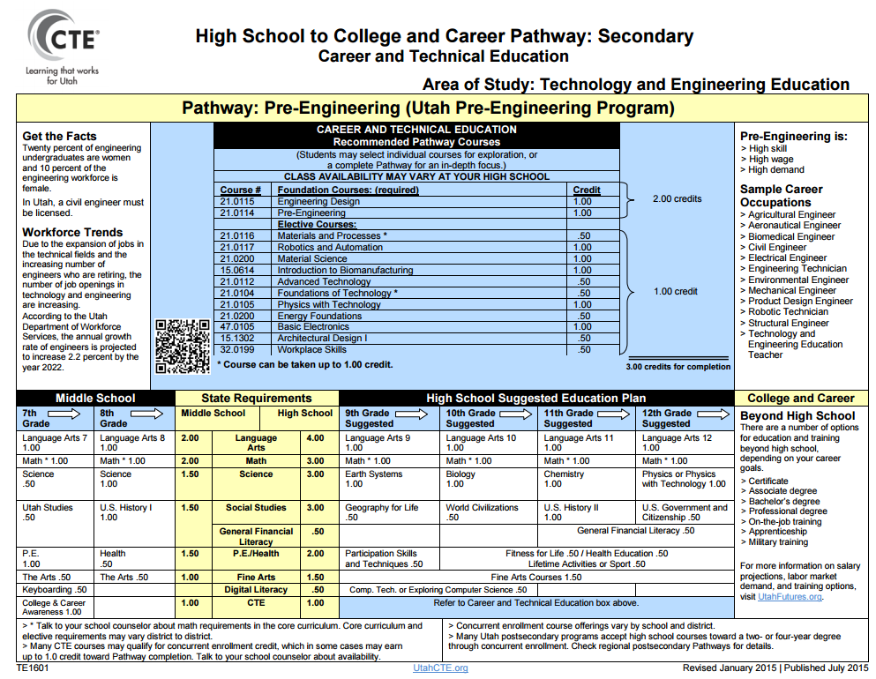
7-9
Electives List
Pre-Engineering

Slide 12
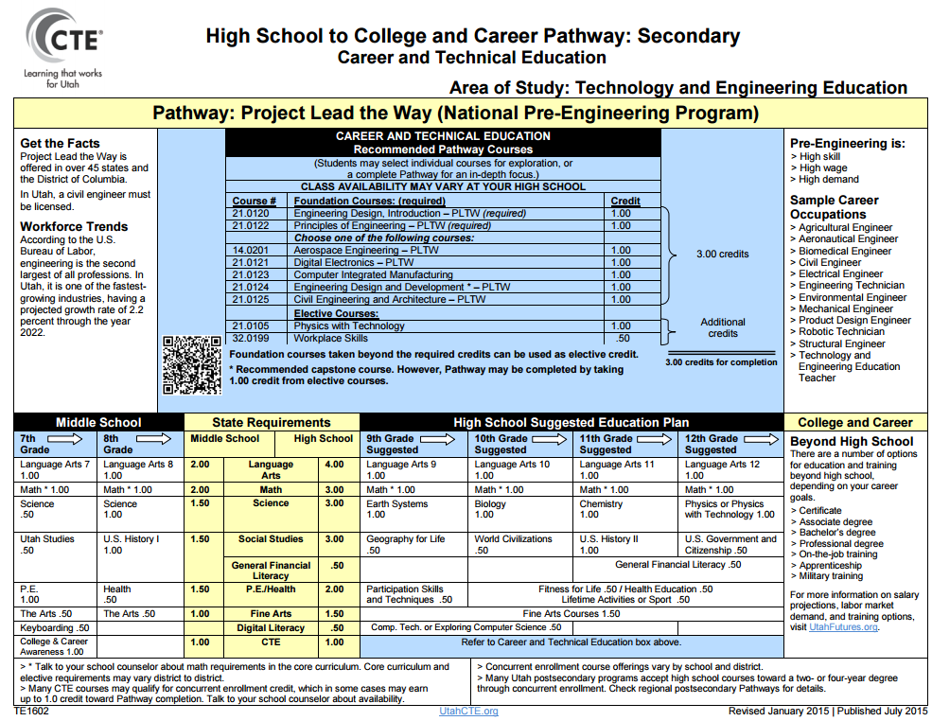
7-9
Electives List
Project Lead the Way

Slide 13
Family & Consumer Science
7-9
Electives List
Consumer Economics Services
Early Childhood Education
Family and Human Services
Fashion Design, Manufacturing & Merchandising
Food Science, Dietetics & Nutrition
Food Services and Culinary Arts

Slide 14
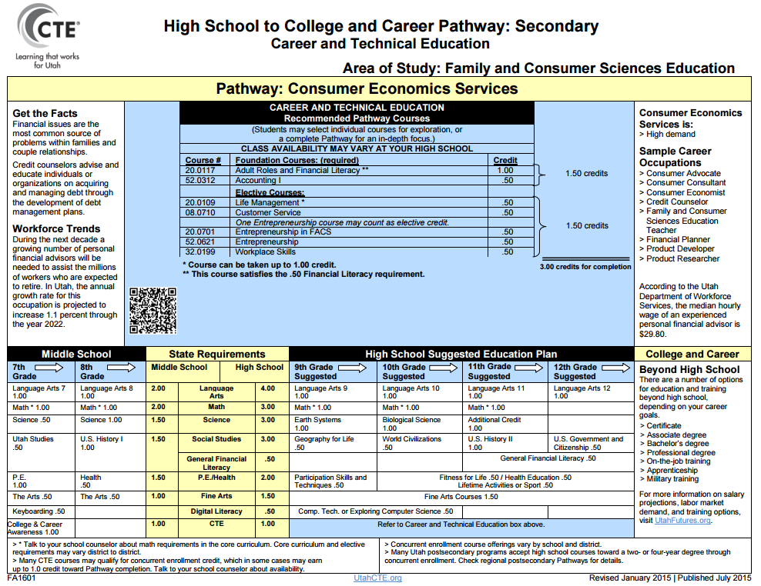
7-9
Electives List
Consumer Economics Services

Slide 15
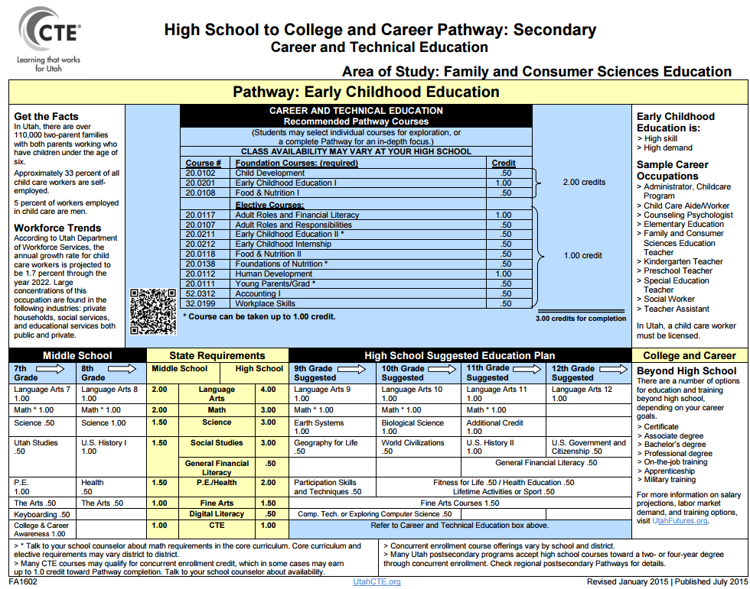
7-9
Electives List
Early Childhood Education

Slide 16
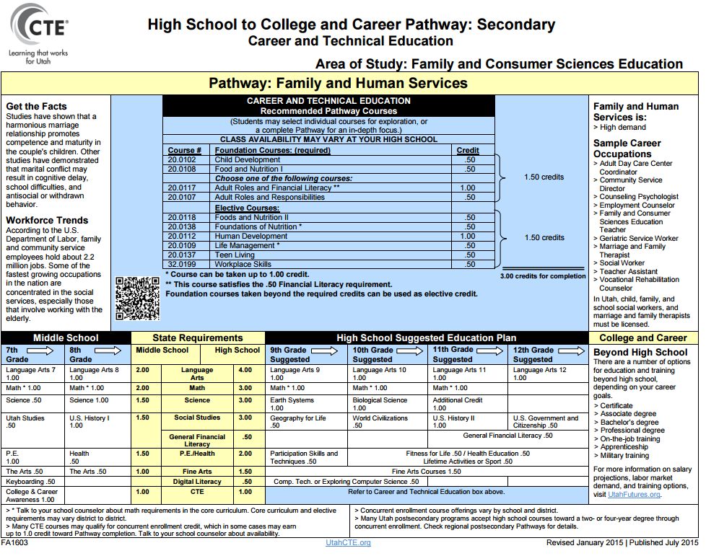
7-9
Electives List
Family and Human Services

Slide 17
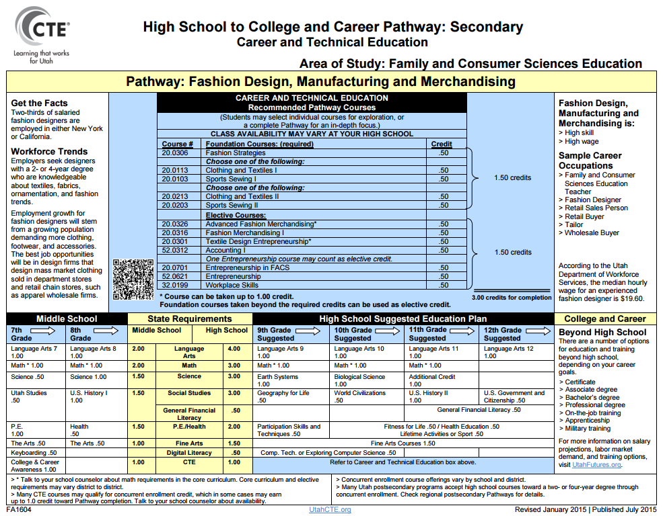
7-9
Electives List
Fashion Design, Manufacturing & Merchandising

Slide 18
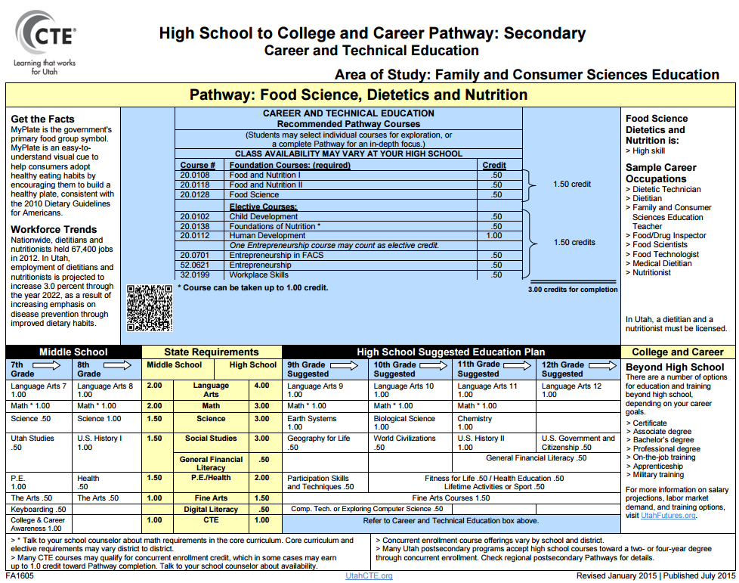
7-9
Electives List
Food Science, Dietetics and Nutrition

Slide 19
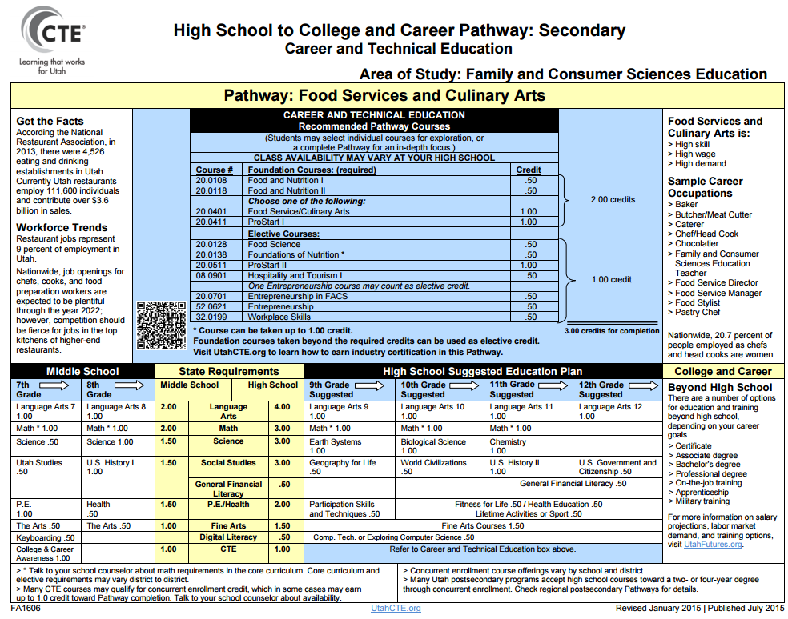
7-9
Electives List
Food Services & Culinary Arts

Slide 20
Health Science
7-9
Electives List
Biotech Research & Development
Diagnostics – Clinical Lab and Medical Forensics
Health Informatics – Medical Office Admin. Assistant
Therapeutic Services – Dental
Therapeutic Services – Emergency Medical
Therapeutic Services – Medical Assistant
Therapeutic Services – Nursing
Therapeutic Services - Pharmacy
Therapeutic Services – Surgical Technician
Therapeutic Services – Rehabilitation/Exercise

Slide 21
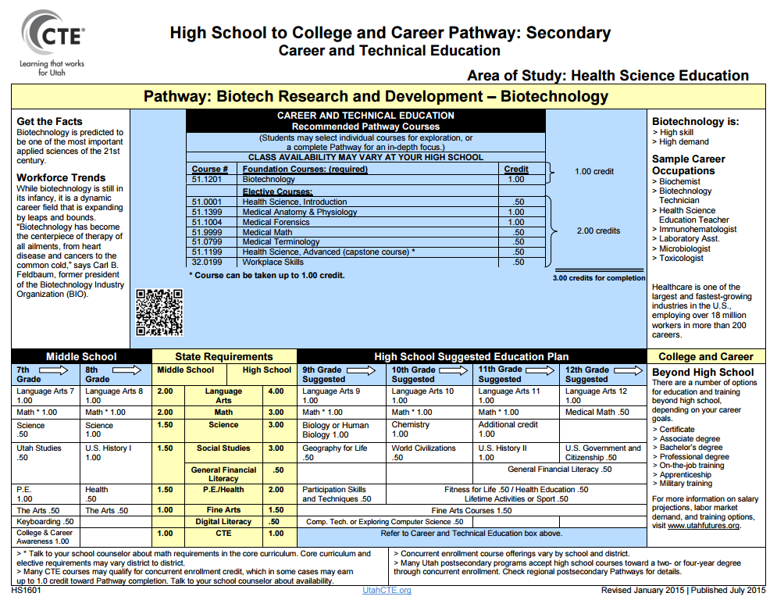
7-9
Electives List
Biotech Research & Development

Slide 22
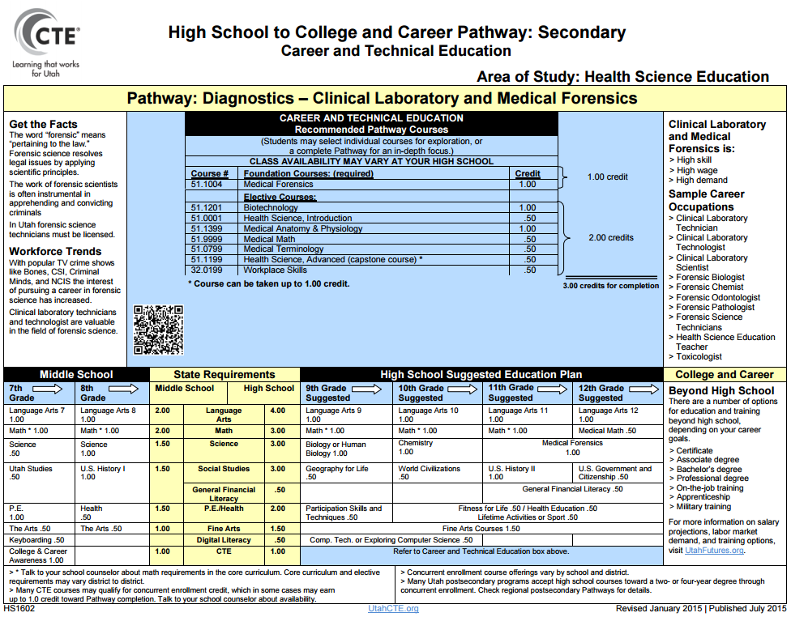
7-9
Electives List
Diagnostics: Clinical & Forensics

Slide 23
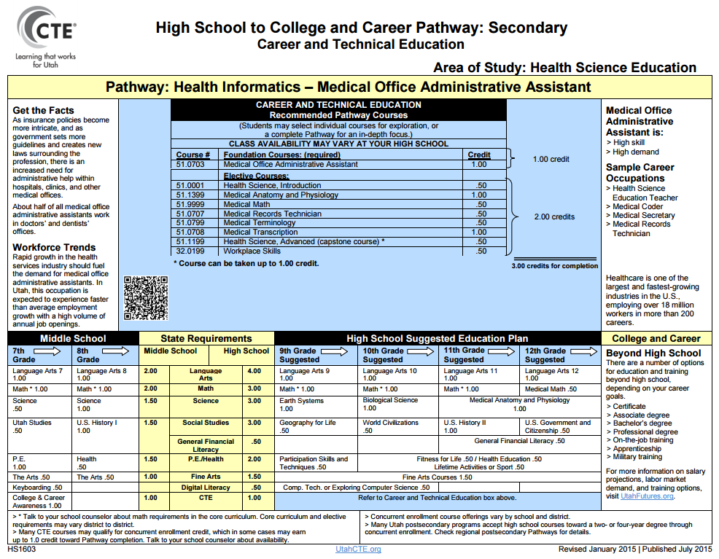
7-9
Electives List
Health Informatics – Medical Office Admin. Assistant

Slide 24
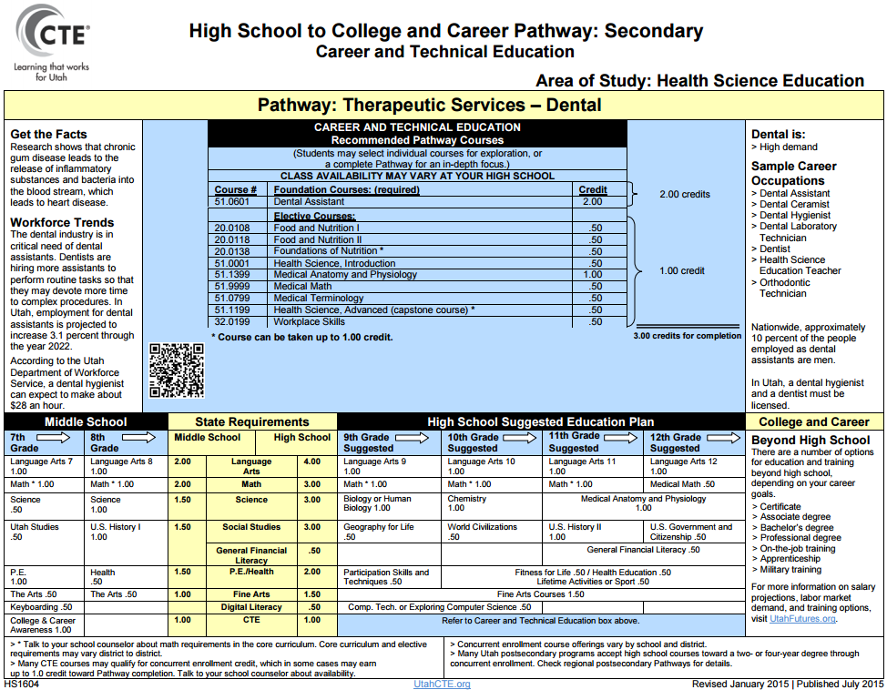
7-9
Electives List
Dental

Slide 25
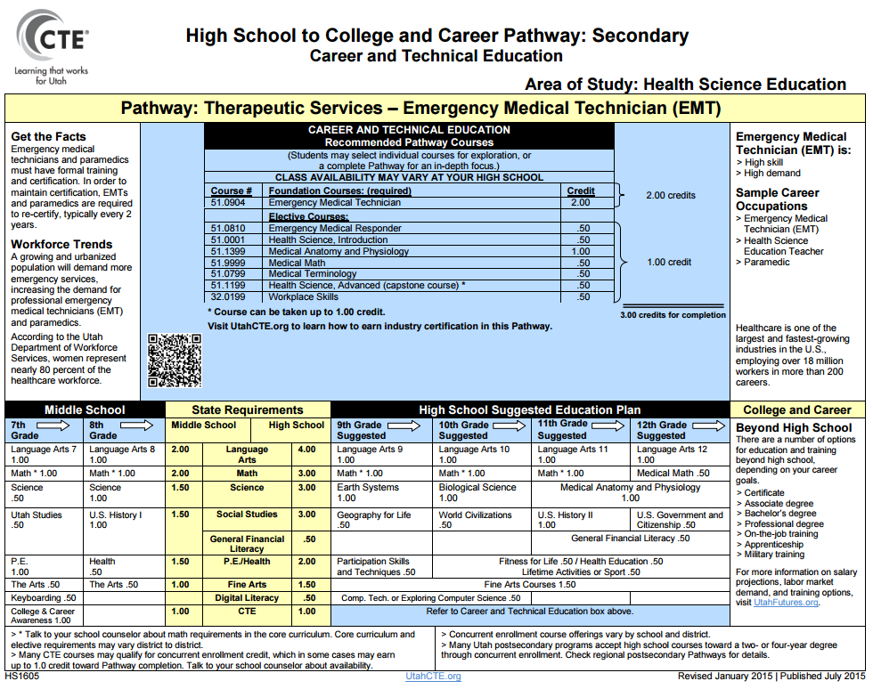
7-9
Electives List
Emergency Medical Technician

Slide 26
7-9
Electives List
Medical Assistant

Slide 27
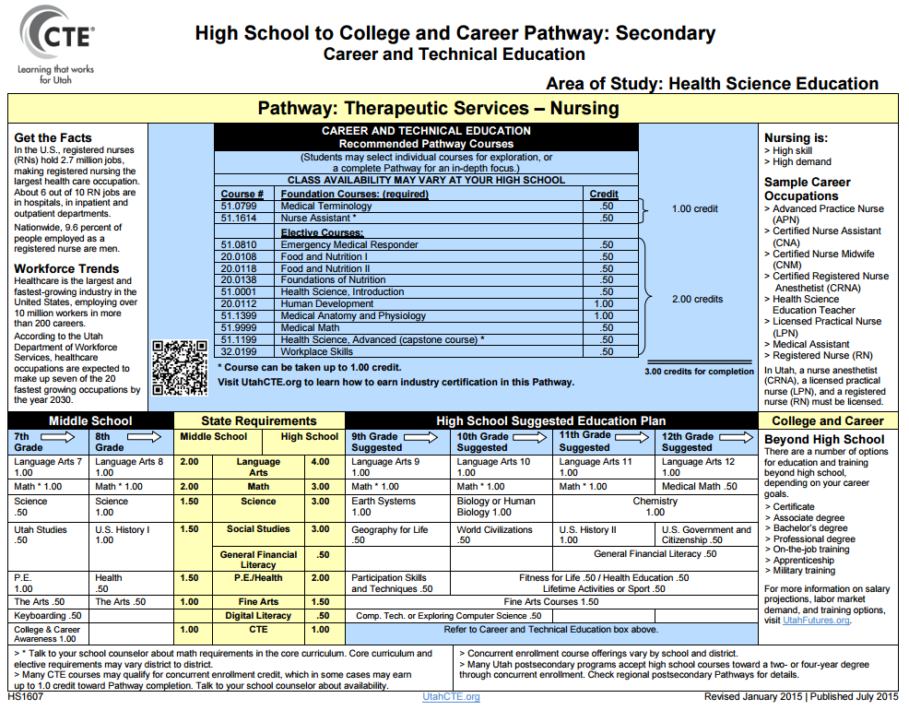
7-9
Electives List
Nursing

Slide 28
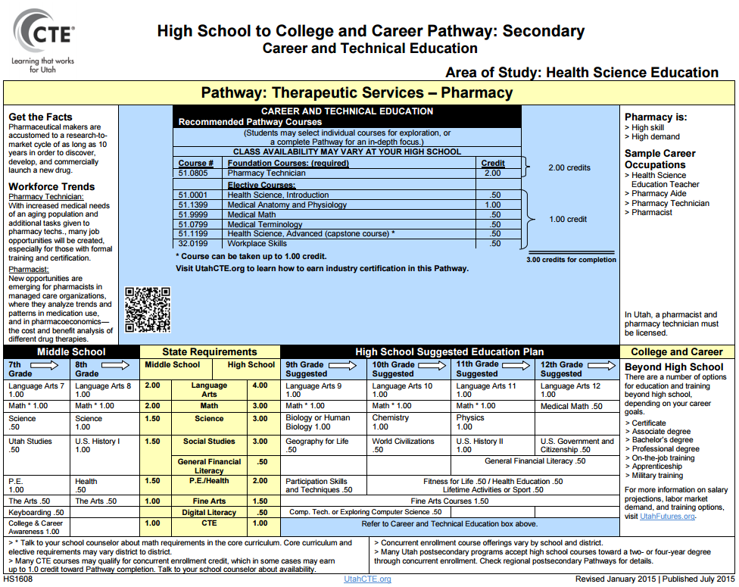
7-9
Electives List
Pharmacy

Slide 29
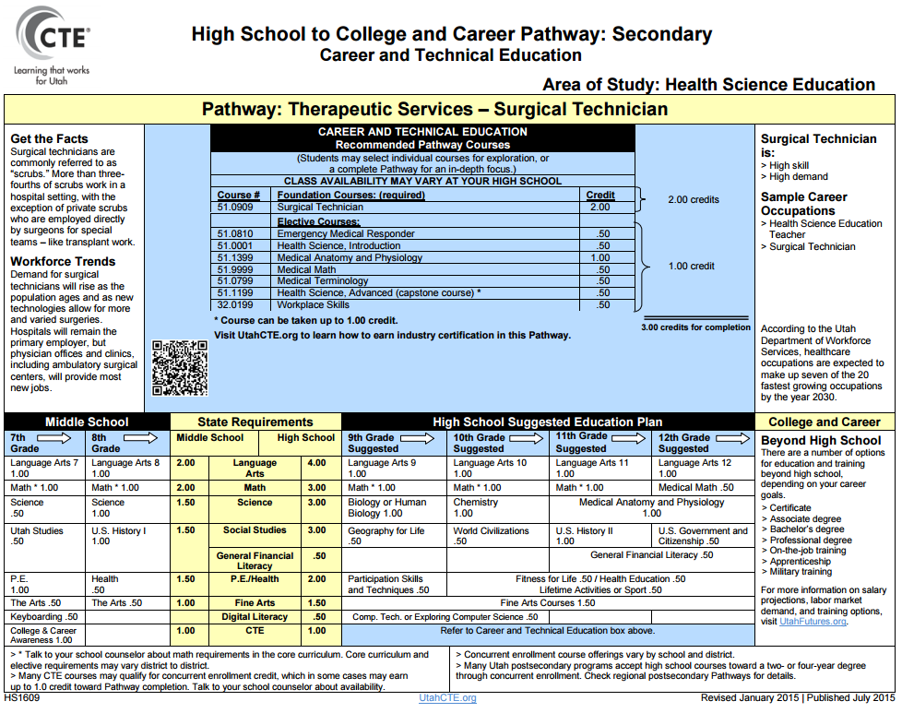
7-9
Electives List
Surgical Technician

Slide 30
7-9
Electives List
Theraputic/Rehabilitation

Slide 31
Information Technology
7-9
Electives List
Digital Media
Network and IT Support
Programming/Software Development
Web Development & Administration

Slide 32
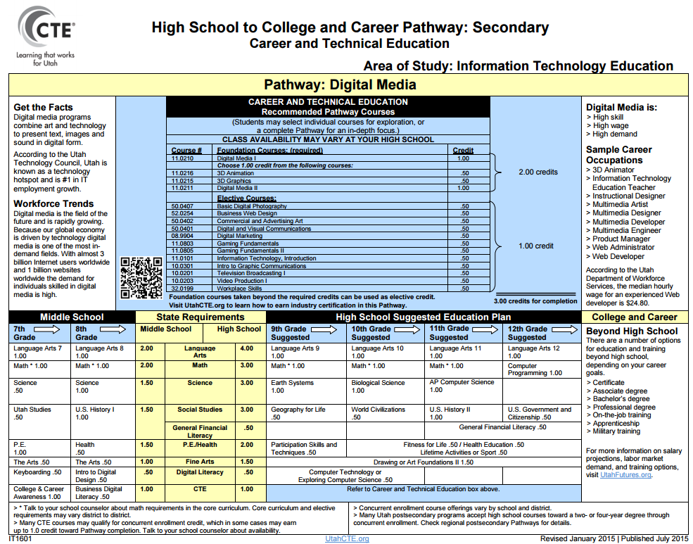
7-9
Electives List
Digital Media

Slide 33
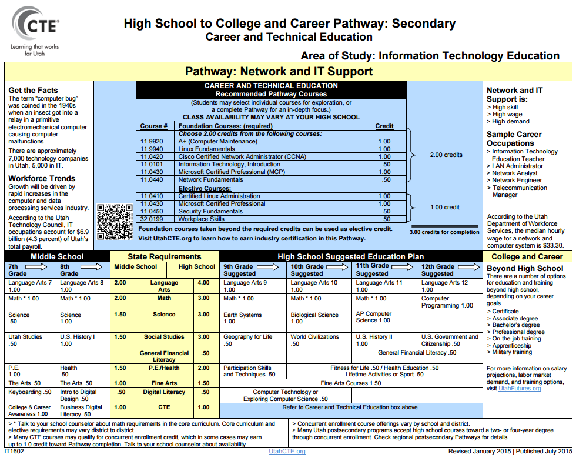
7-9
Electives List
Network and IT Support

Slide 34
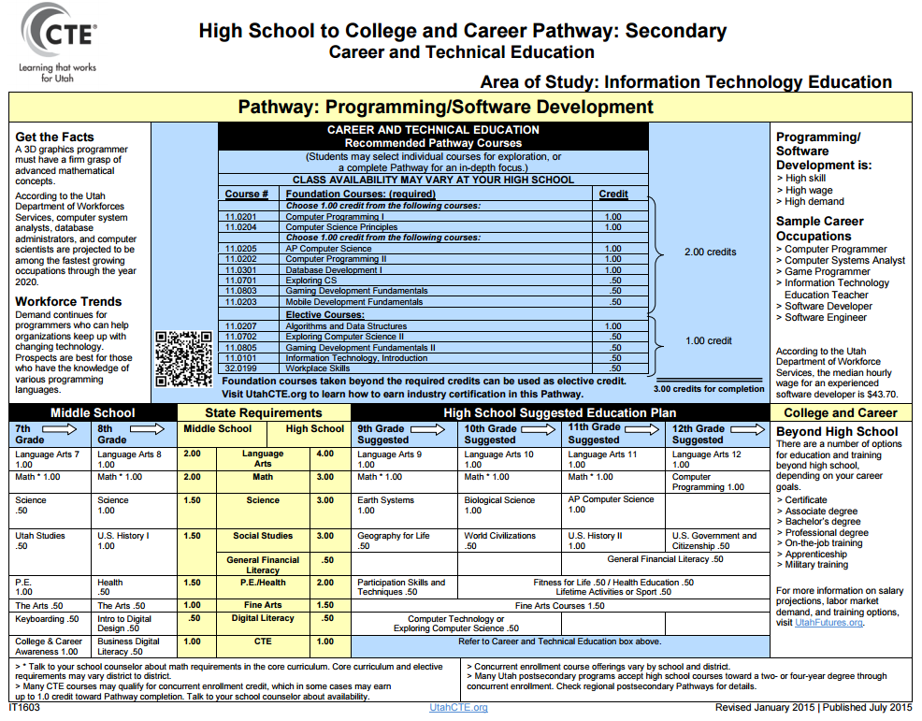
7-9
Electives List
Programming/Software Development

Slide 35
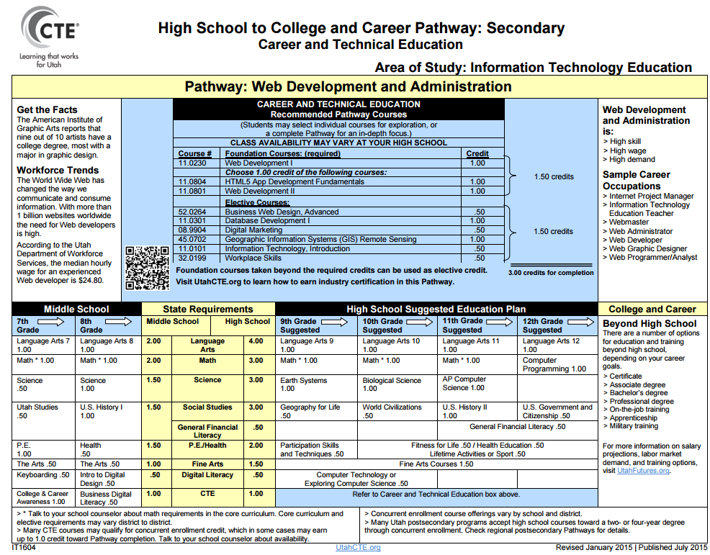
7-9
Electives List
Web Development

Slide 36
Agriculture
7-9
Electives List
Agricultural Systems Technology
Animal Systems
Food Production & Processing Systems
Natural Resource Systems
Plant Systems

Slide 37
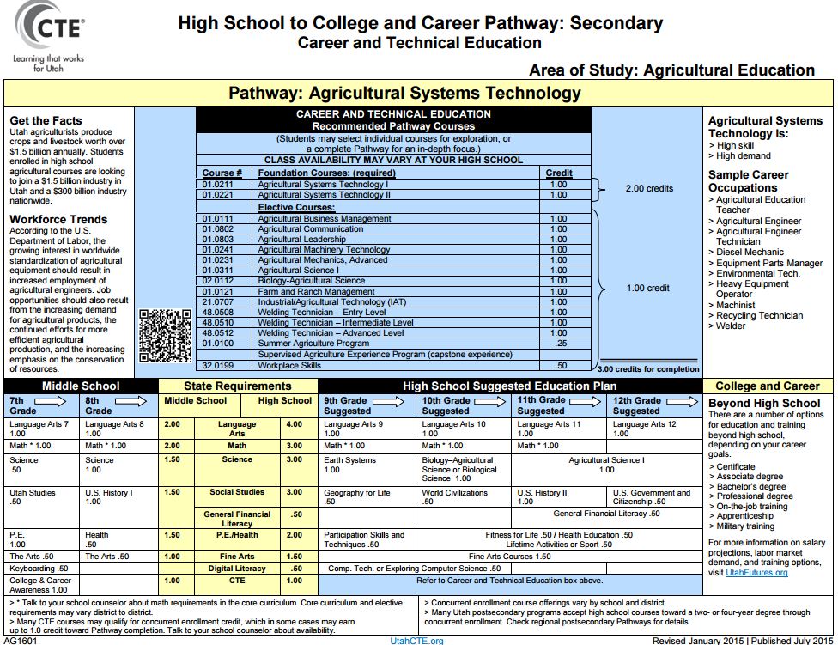
7-9
Electives List
Agricultural Systems Technology

Slide 38
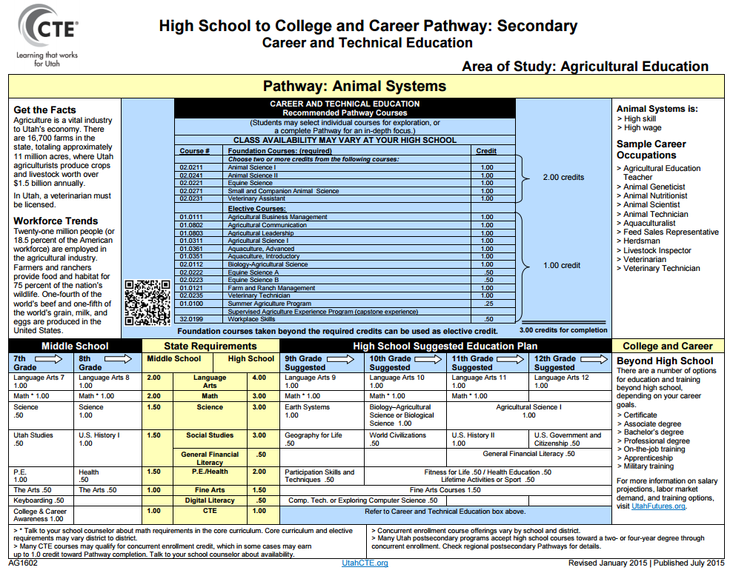
7-9
Electives List
Animal Systems

Slide 39
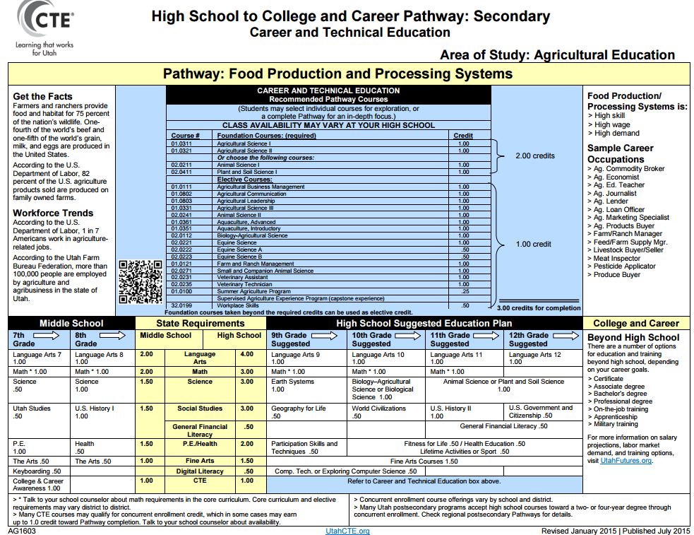
7-9
Electives List
Food Production & Processing Systems

Slide 40
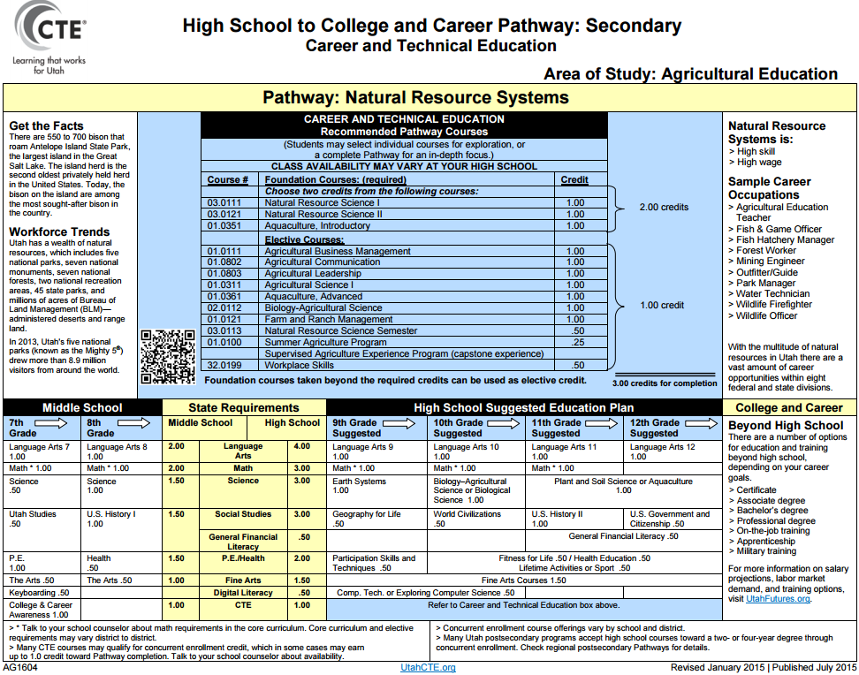
Natural Resource Systems

Slide 41
7-9
Electives List
Plant Systems

Slide 42
Skilled & Technical Sciences
7-9
Electives List
Carpentry
Electrician
HVAC (Heating & Air)
Plumbing
Radio Broadcasting
Television Broadcasting
Automotive Collision Repair
Automotive Service Technician
Electronics Repairs
Heavy Duty Diesel Repair
Cosmetology/Barbering
Esthetician/Nail Technician
Cabinetmaking/Millwork
Design Technology
Graphics/Printing
Machine Tool
Welding
Firefighting
Law Enforcement
Aviation Technology
Commercial Art
Commercial Photography

Slide 43
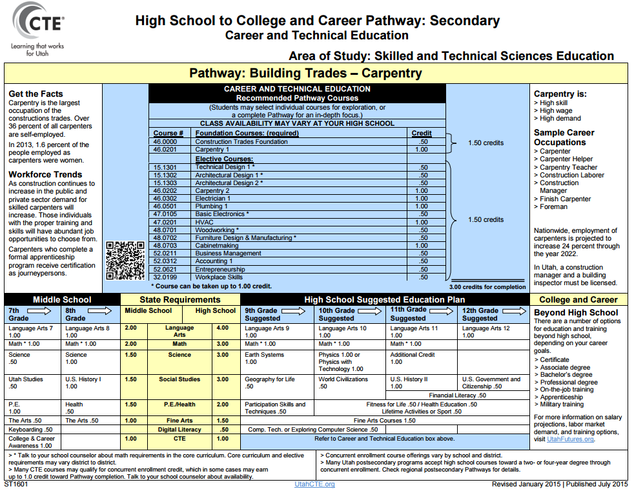
7-9
Electives List
Carpentry

Slide 44
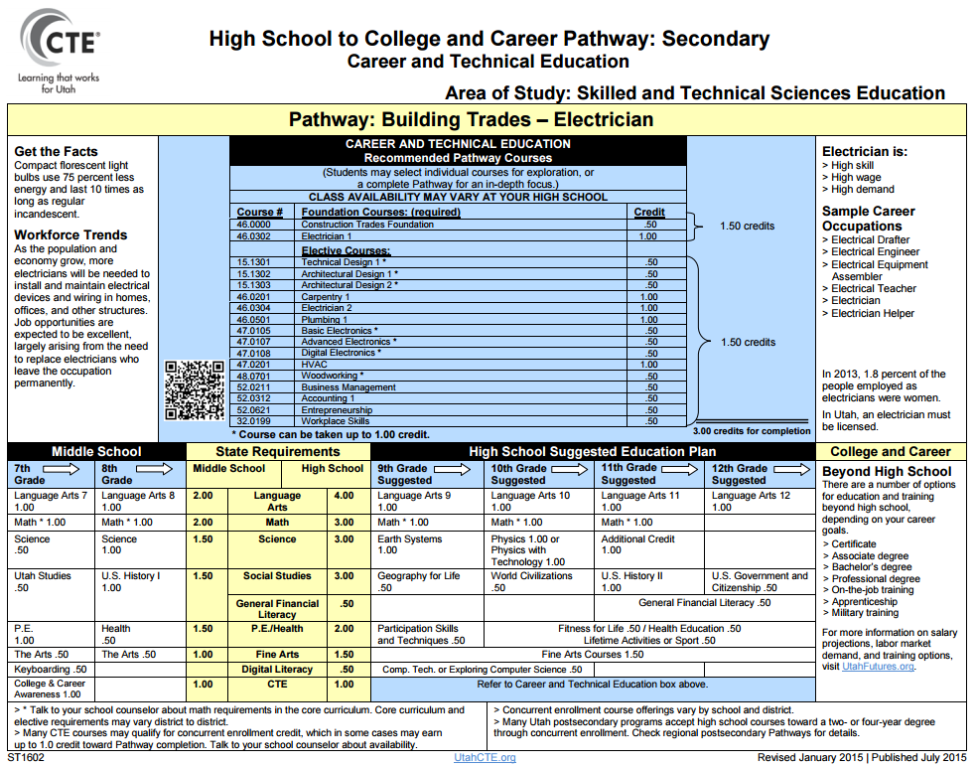
7-9
Electives List
Electrician

Slide 45
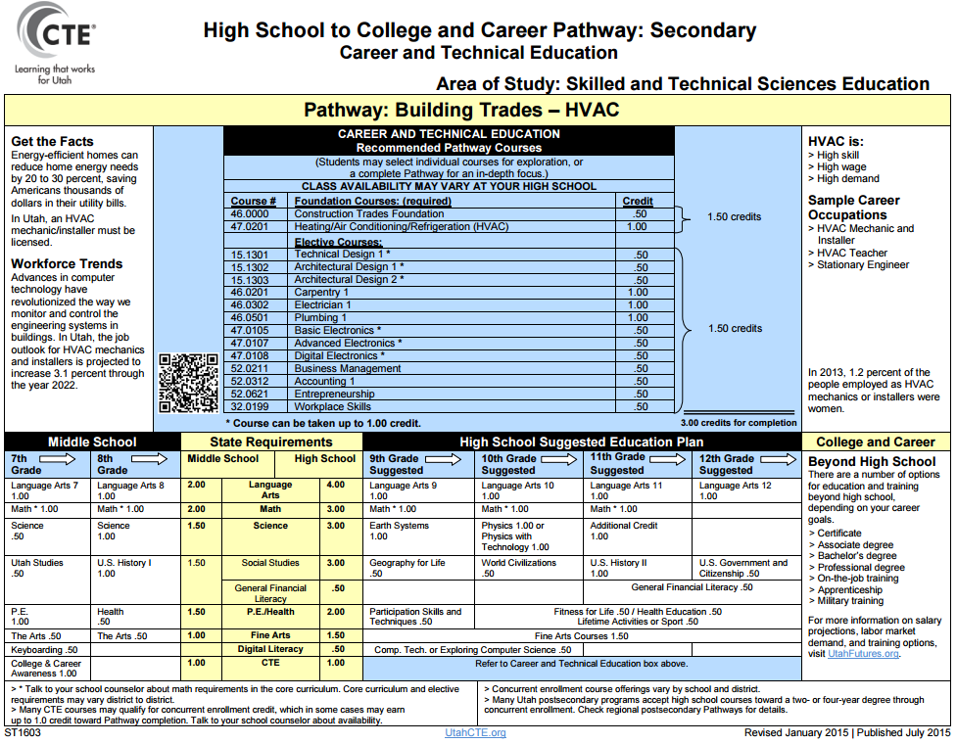
7-9
Electives List
HVAC

Slide 46
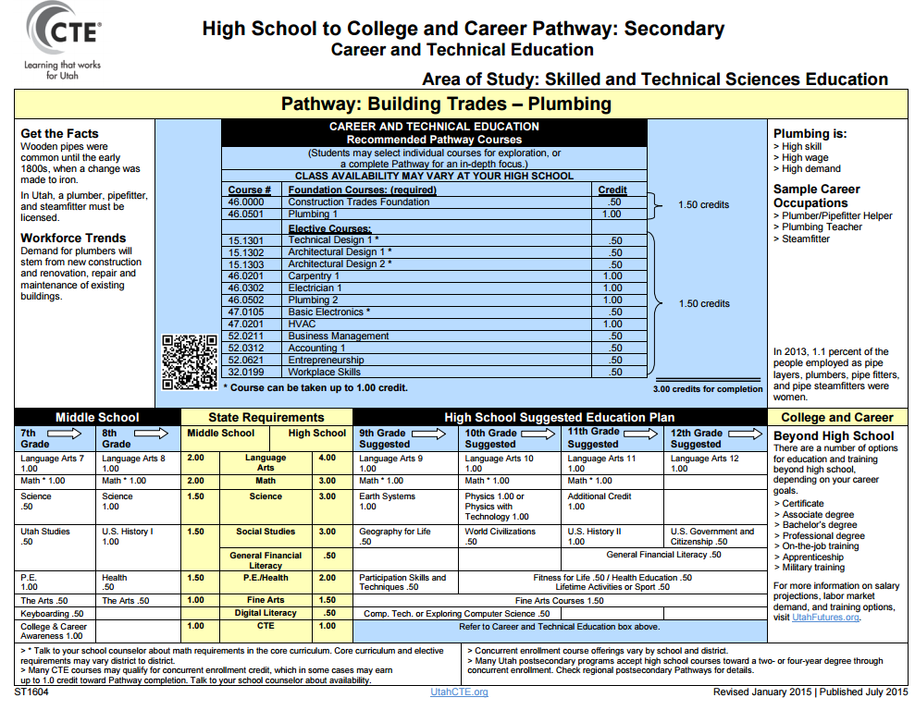
7-9
Electives List
Plumbing

Slide 47
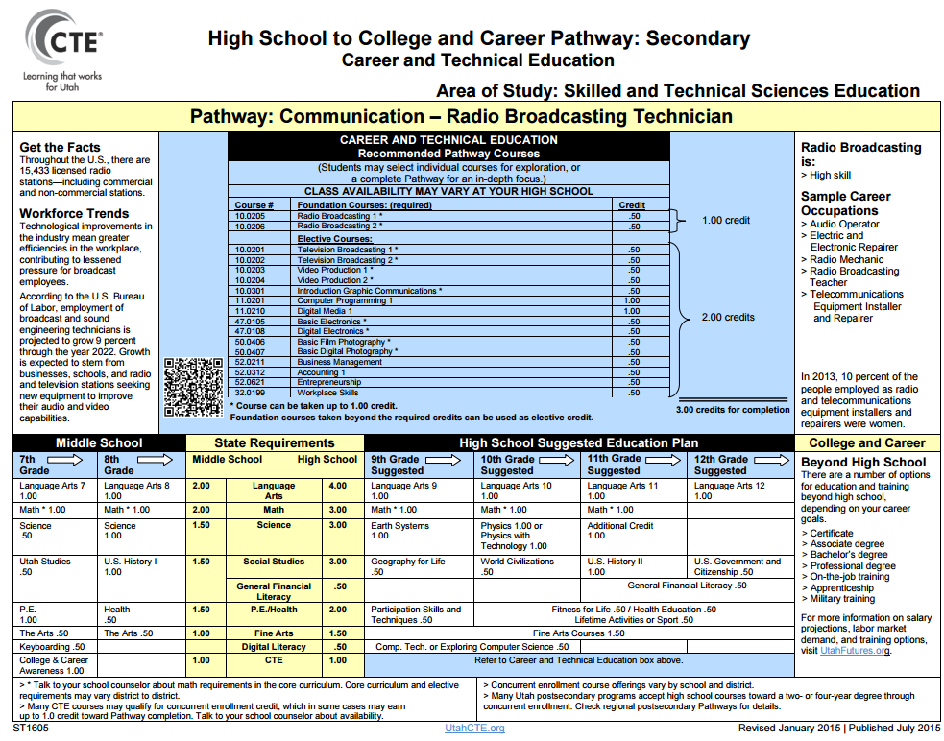
7-9
Electives List
Radio Broadcasting

Slide 48
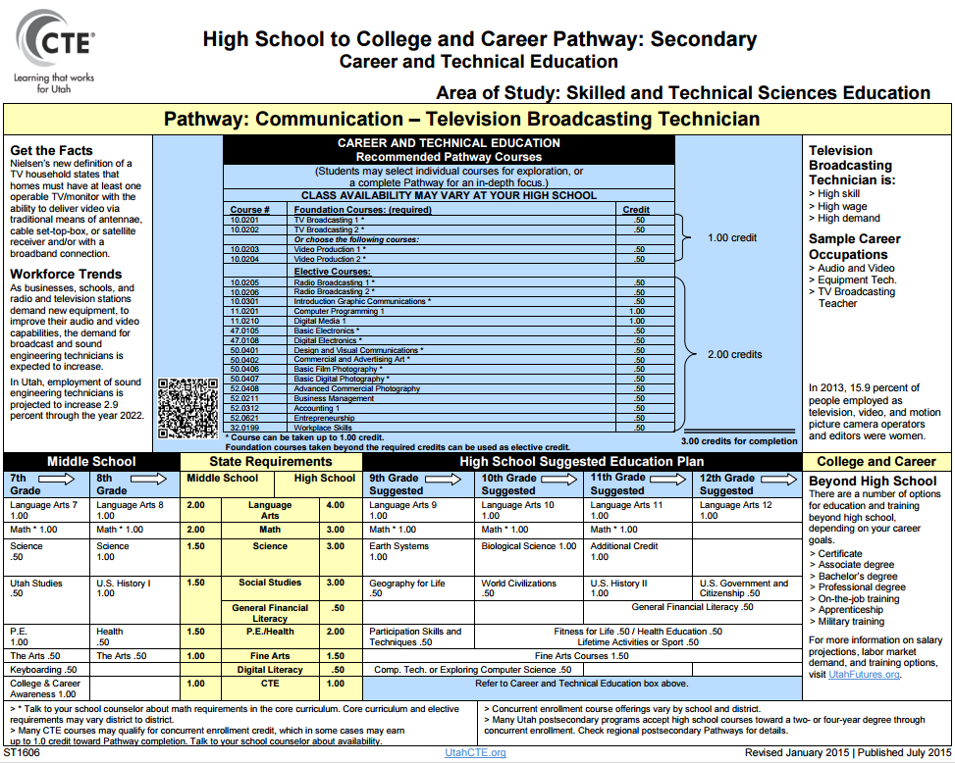
7-9
Electives List
Television Broadcasting

Slide 49
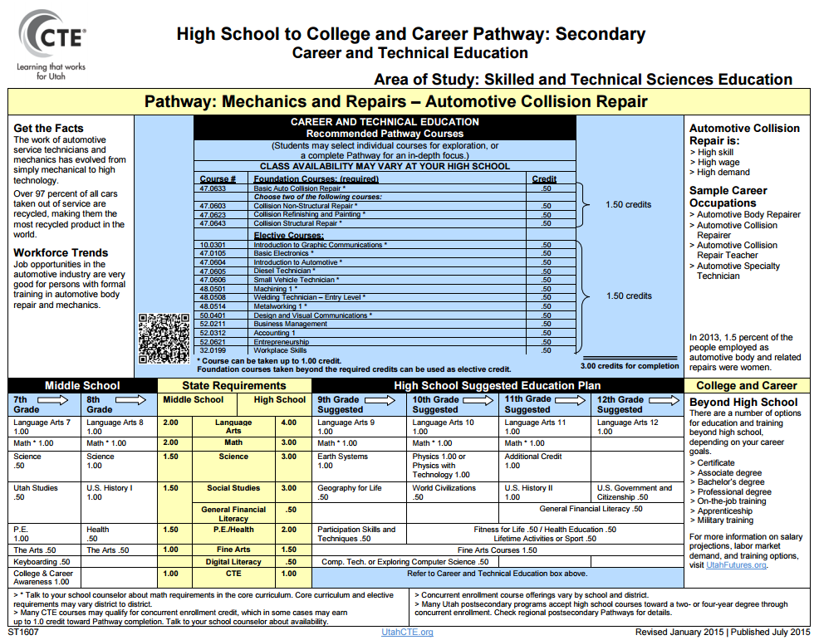
7-9
Electives List
Automotive Collision Repair

Slide 50
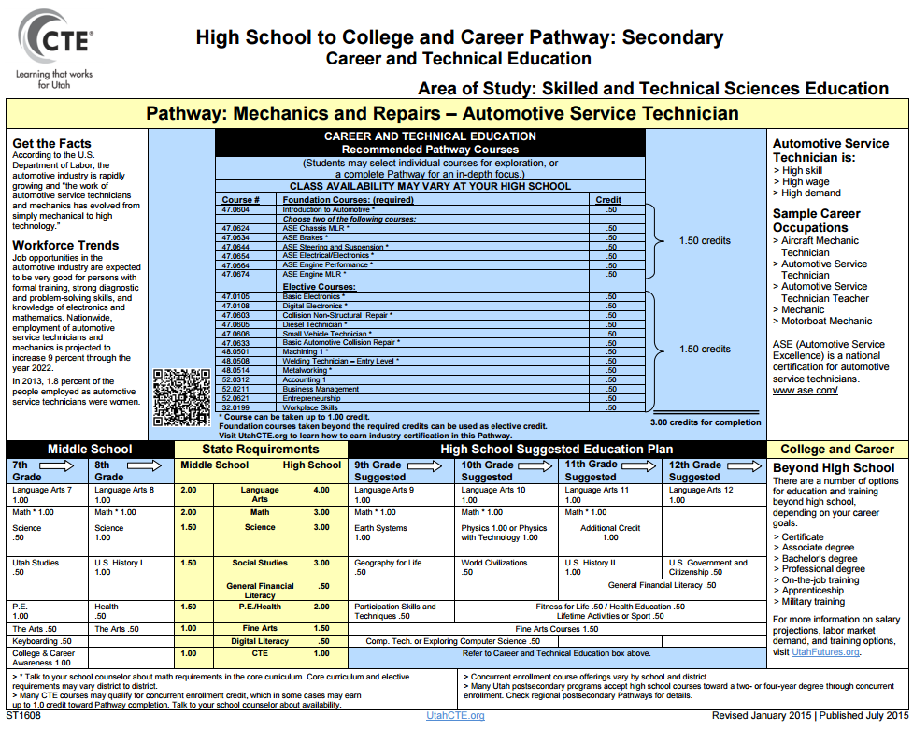
7-9
Electives List
Automotive Service Technician

Slide 51
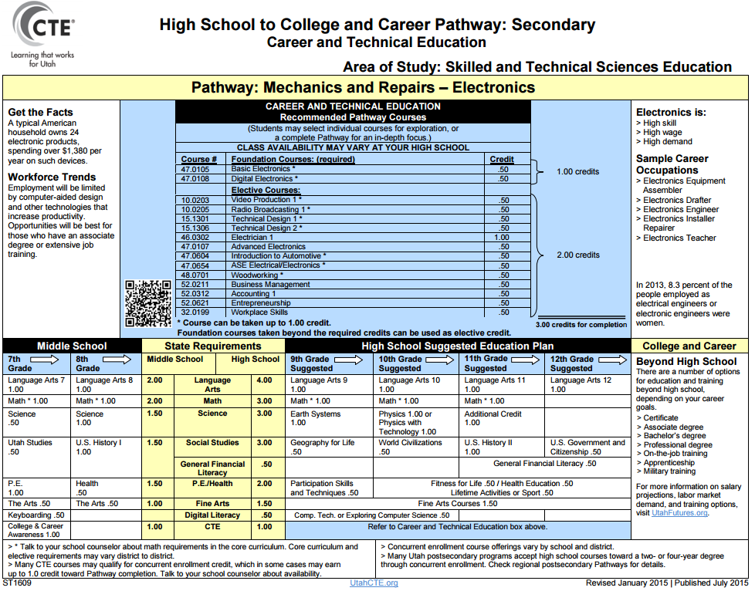
7-9
Electives List
Electronics Repiar

Slide 52
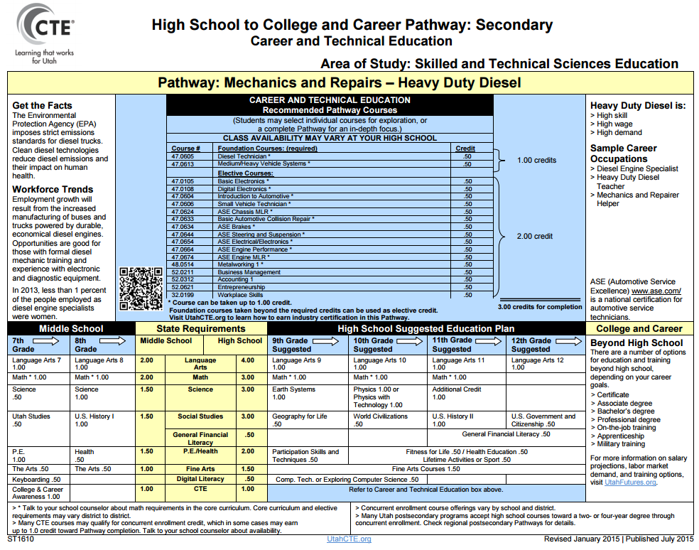
7-9
Electives List
Heavy Duty Diesel Repair

Slide 53
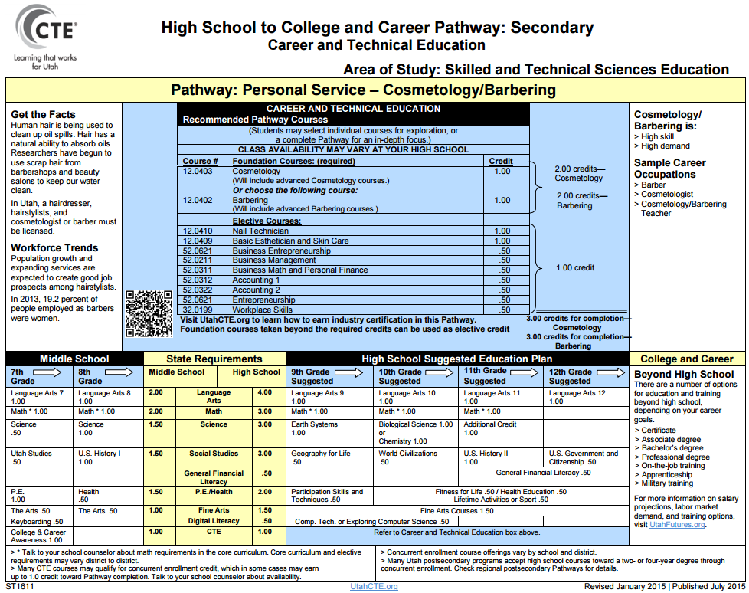
7-9
Electives List
Cosmetology/Barbering

Slide 54
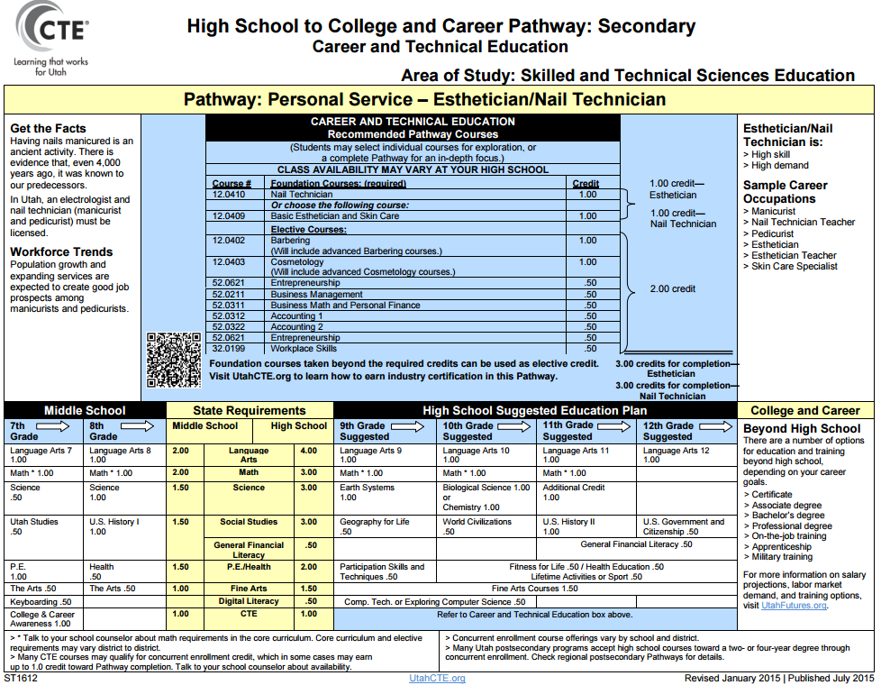
7-9
Electives List
Esthetician/Nail Technician

Slide 55
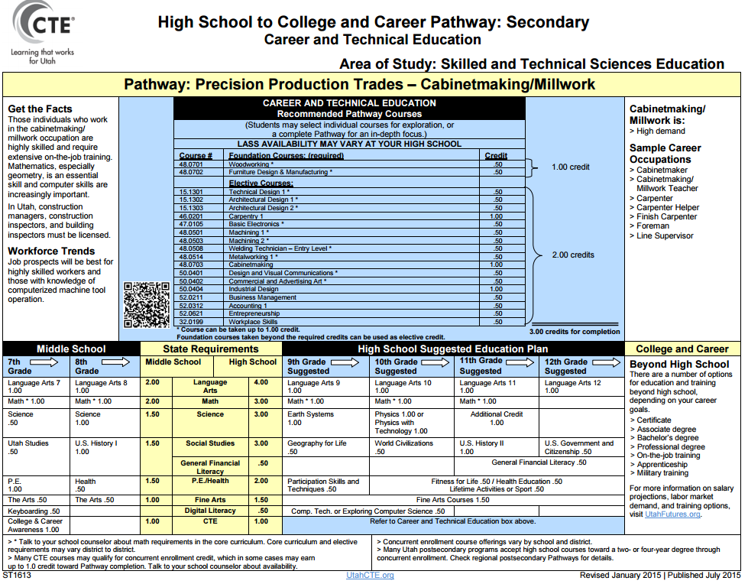
7-9
Electives List
Cabinetmaking/Millwork

Slide 56
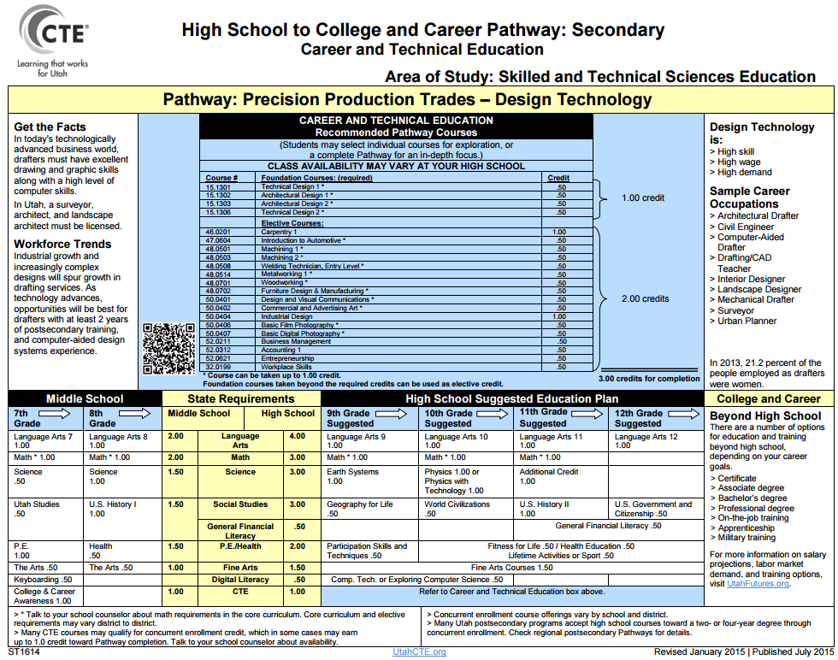
7-9
Electives List
Design Technology

Slide 57
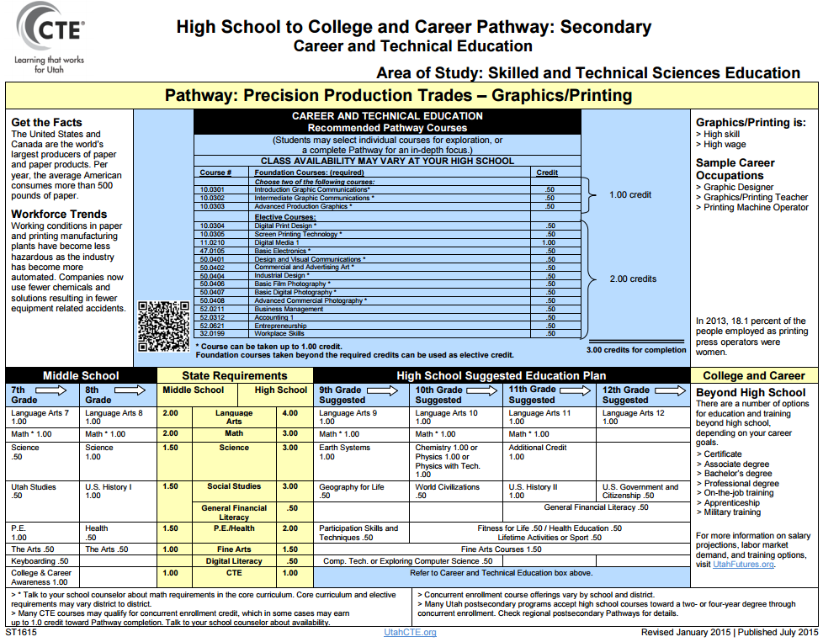
7-9
Electives List
Graphics/Printing

Slide 58
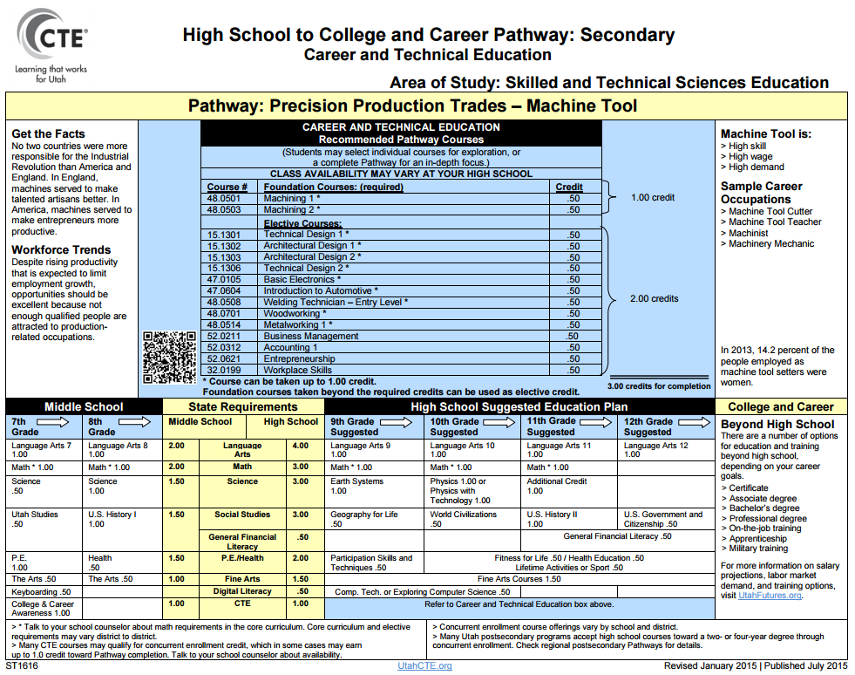
7-9
Electives List
Machine Tool

Slide 59
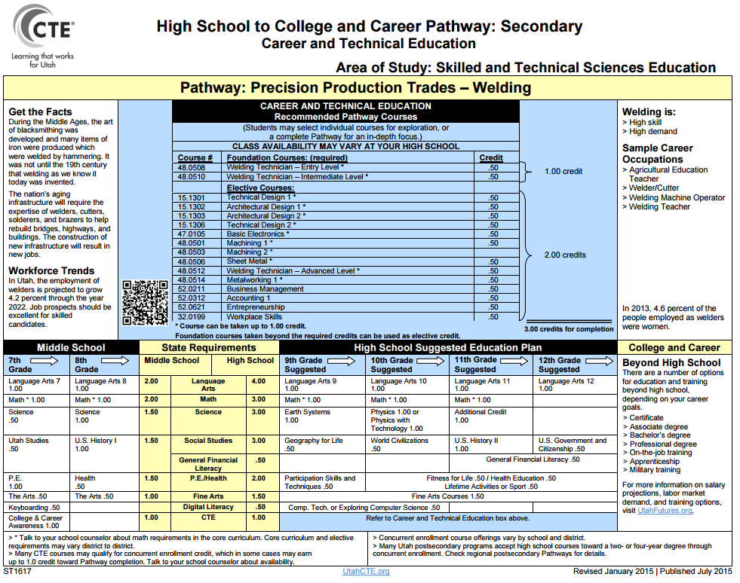
7-9
Electives List
Welding

Slide 60
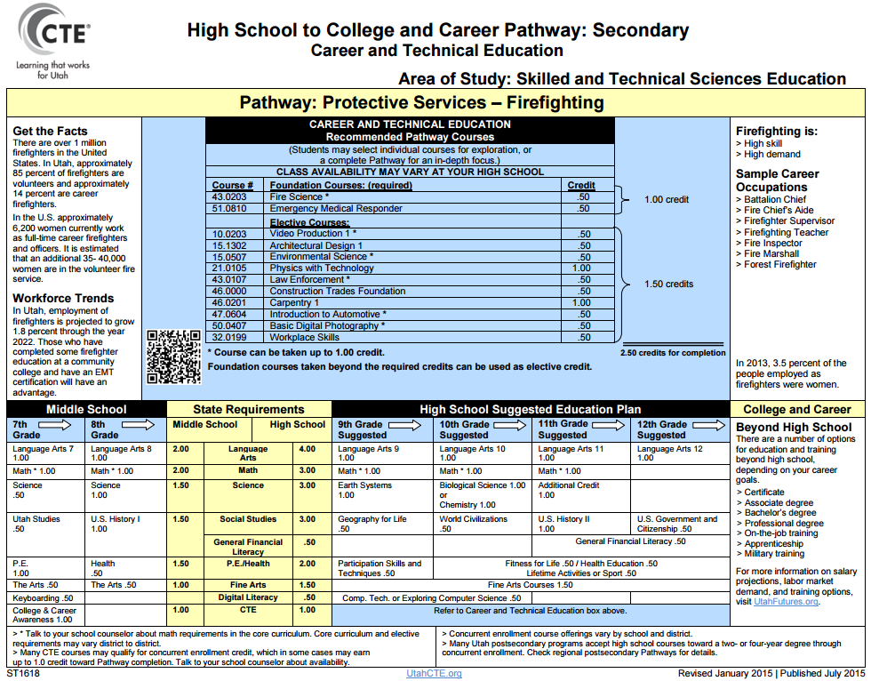
7-9
Electives List
Firefighting

Slide 61
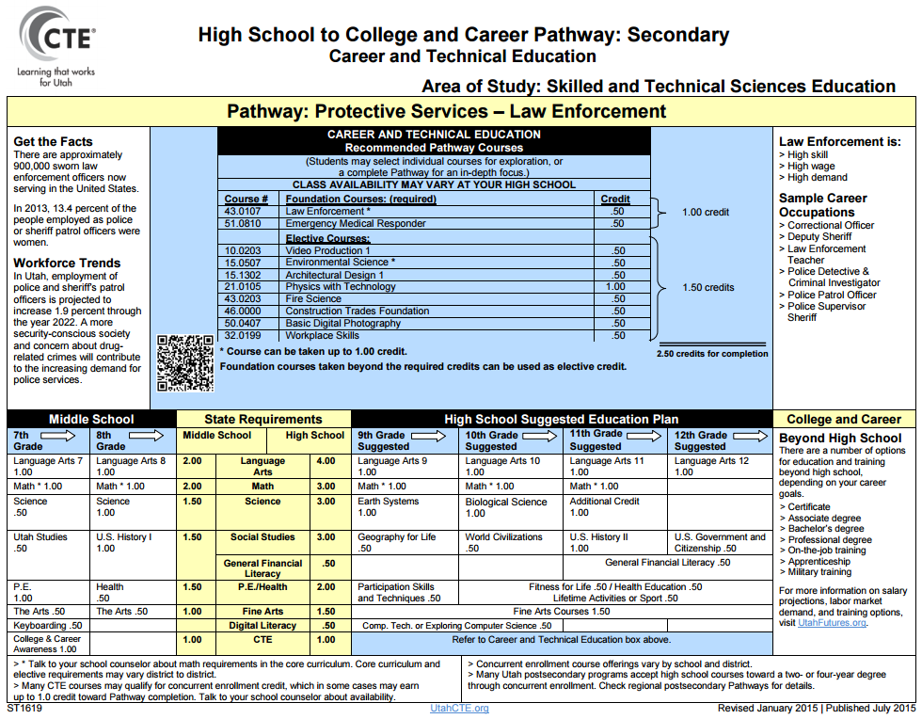
7-9
Electives List
Law Enforcement

Slide 62
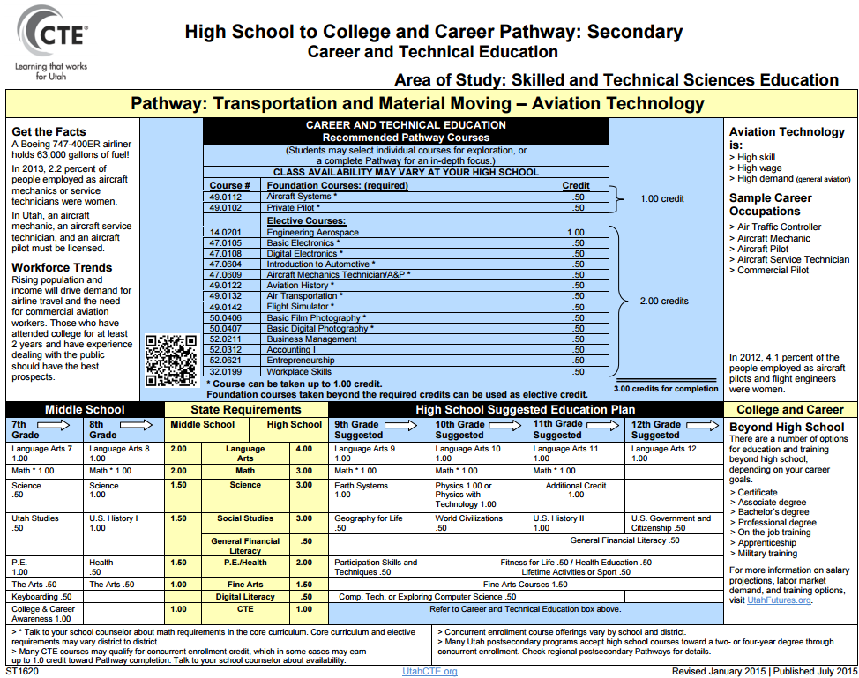
7-9
Electives List
Aviation Technology

Slide 63
7-9
Electives List
Commercial Art

Slide 64
7-9
Electives List
Commercial Photography

